Slide 1
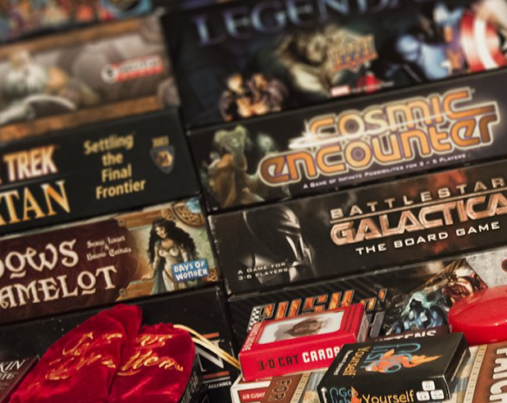
Modern Board Gaming
13 Jun 2020
Ross Glenn

Slide 2
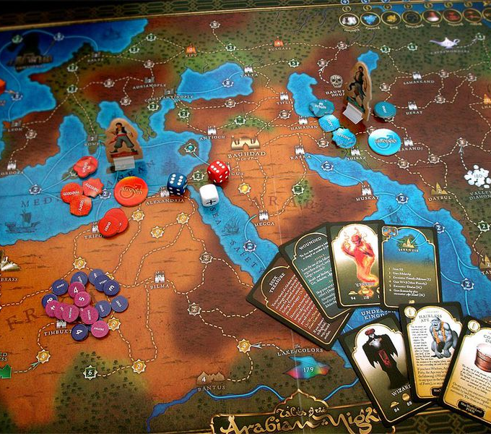
Board Gaming!
Table of Contents
Why board gaming?
The Classics… and their replacements
Board Game Styles, Genres, Mechanics
The New Classics
Joining the Hobby
Tales of the Arabian Nights

Slide 3
Ground Rules!
My preferences…
I won’t be talking about…
I like games where even the loser is having a good time
I like games where player “dead time” or waiting time between turns is minimized
I tend to like games with a lot of positive player interaction, but…
I also tend to like games where you can choose between your own goals or hampering other people’s goals
This means I tend to like games with a lot of interesting choices
I tend to avoid games with overly mechanical rules systems… if a computer can play the game far better than a human, I avoid that game
Collectible Card Games (CCGs)
Role-Playing Games (RPGs)
Tabletop War Gaming
Few Card or “Filler” Games
Few Two Player Games
Few “All-Day” Games

Slide 4
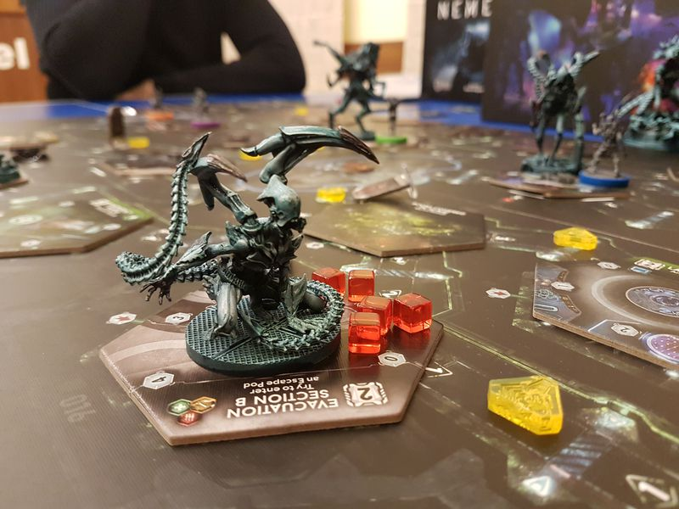
Why?
Nemesis

Slide 5
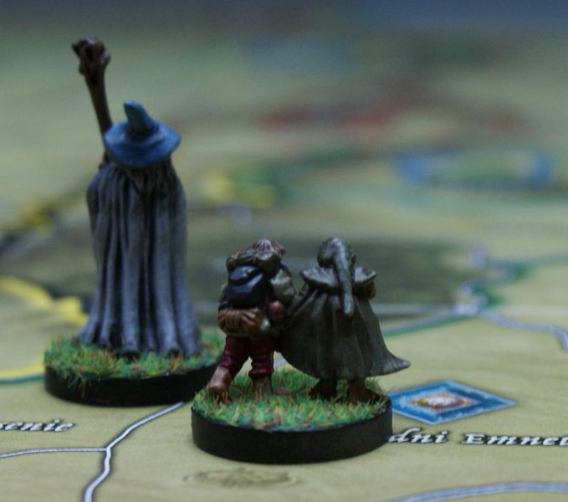
Why?
The last ten years has seen an explosion of face-to-face gaming
Every aspect of face-to-face gaming is through the roof: starting with the poker craze of a few years ago and followed by Collectible Card Games and table-top war games
These days, it’s role-playing games and a new generation of board games
Lord of the Rings: War of the Ring

Slide 6
Why?
Put down your phone and have a look at the person across the table from you…
The Human Element
Mislead
Estimate
Board gaming is a social experience… it’s a backlash against our increasingly digital existence
Board gaming is tactile
Board gaming is cheap entertainment
Board gaming creates good memories
Board gaming engages all of your senses
Board gaming reduces stress
Board gaming tickles your brain
Predict
Pretend
Plan
Persuade
Think
Bluff
Calculate
Translate
Assess
Deduce

Slide 7
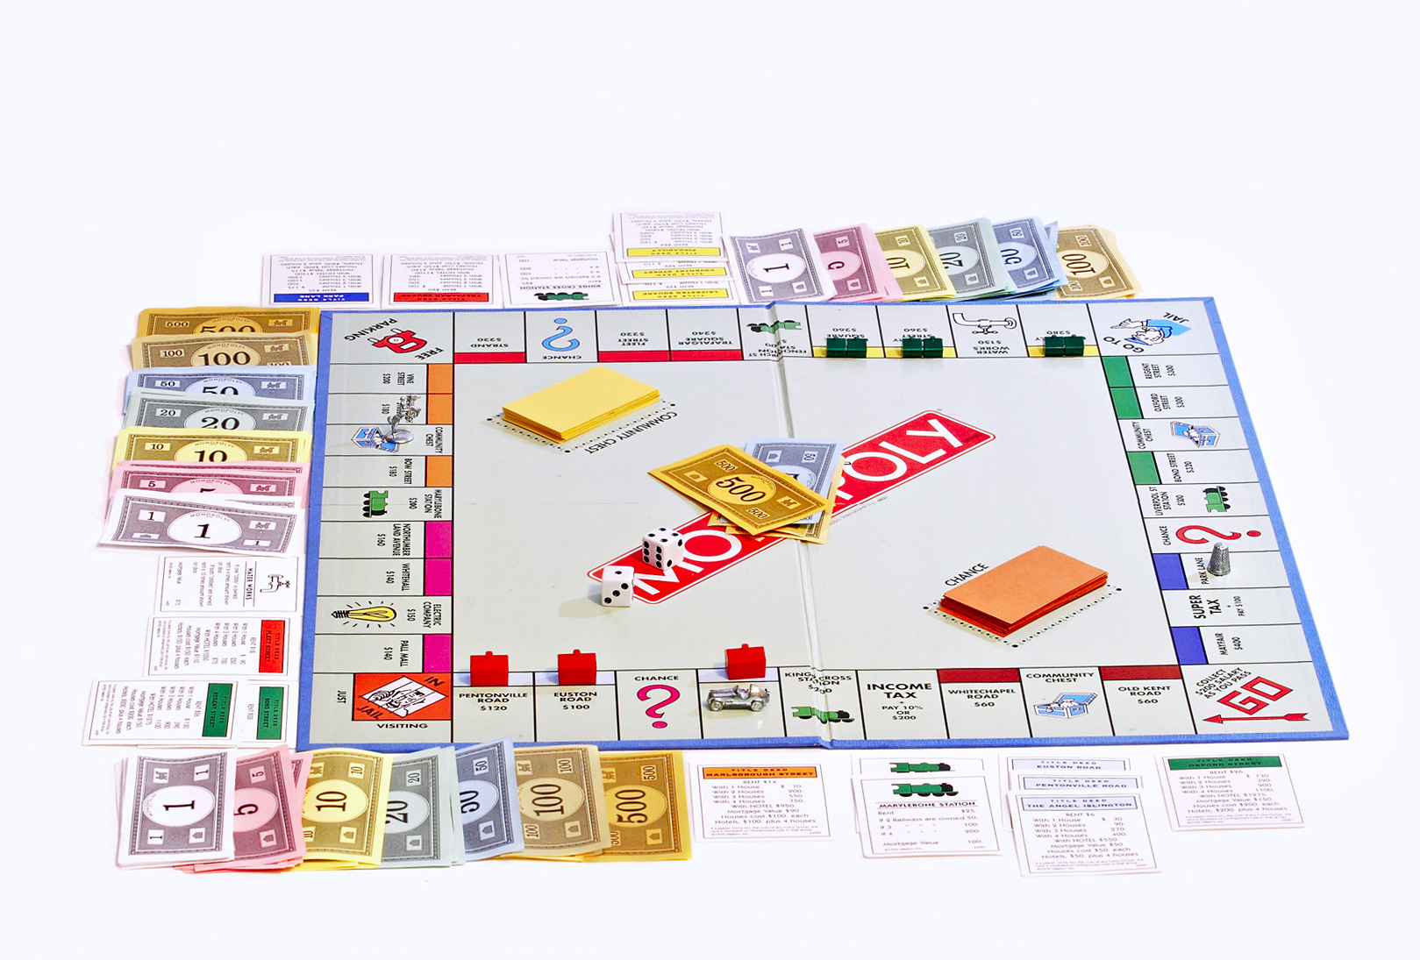
Classics

Slide 8
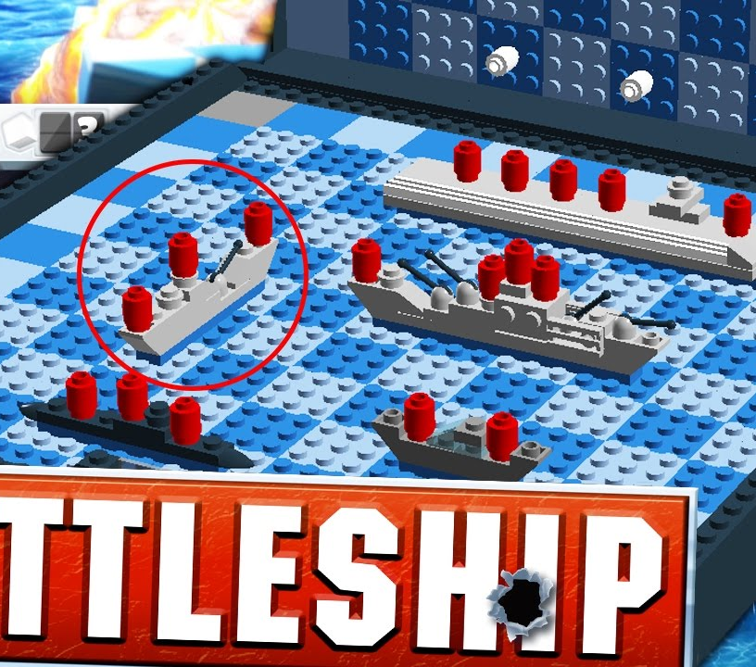
Classics
Some like the classics, but they’ve fallen out of favor…
For decades, board gaming was considered something only for kids
Hard-core war gaming started to change that, as did CCGs, which opened new possibilities
The disadvantages of the classics were laid bare, and new games appeared to challenge old standbys

Slide 9
I enjoy…
Instead…
What is fun about Monopoly?
The feeling of growing power
Building combinations
What are the problems?
All player interaction is negative
Only the winners are having fun
Losing players will tend to check out
Concordia
Keeps the fun of growing power
Adds lots of player interaction
When other players take their turns, those turns often mean positive things for you!

Slide 10
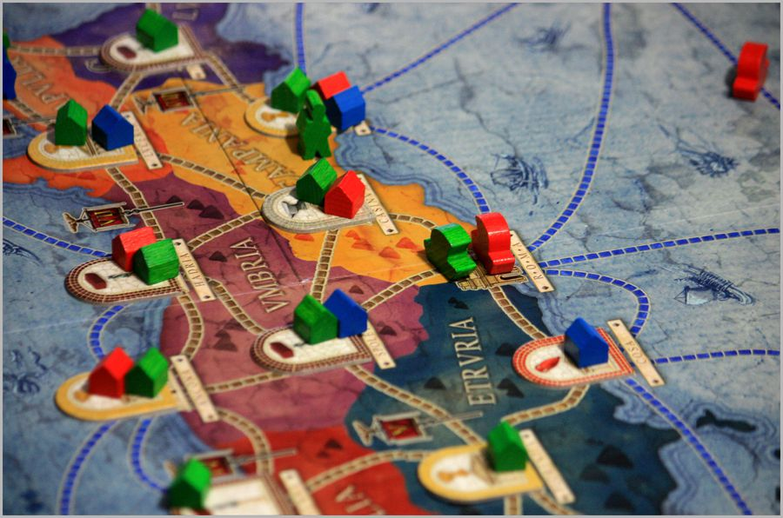
Concordia
One possible action: green “activates” the purple or yellow territories. That gives him resources!
But in either case, it also gives red and blue resources at the same time!
Concordia mechanics:
Drafting, Economics, Worker Placement

Slide 11
I enjoy…
Instead…
What is fun about Risk?
Crushing your enemies
Driving them before you
Hearing the lamentation of the women
What are the problems?
Most of the players are being crushed
Losing players are out of the game
Only two people are having fun
Small World
Every single turn is about using many armies to defeat few armies
Everyone gets to crush their opponents all the time
Keeps the fun of conquering territories and takes dice mostly out of the picture

Slide 12
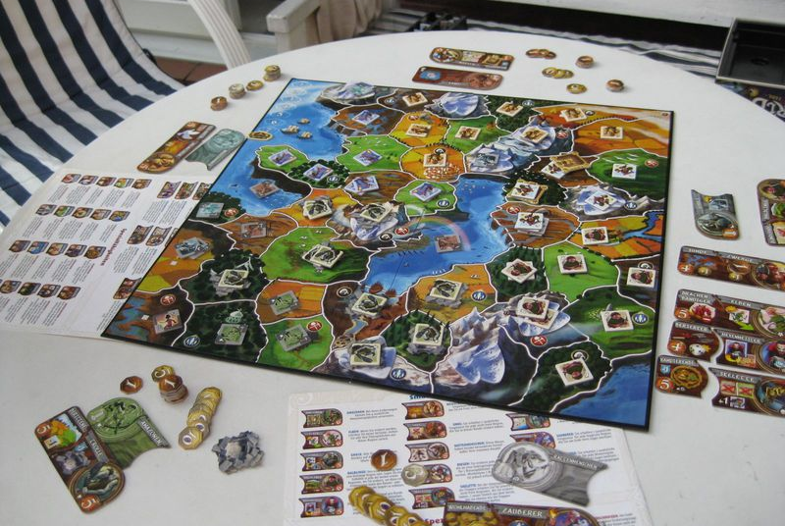
Small World
The goal of Small World is the same as Risk: conquer as much territory as you can.
But no territory is ever safe: they are constantly being conquered through the whole game!
Small World mechanics:
Area Control, Variable Powers

Slide 13
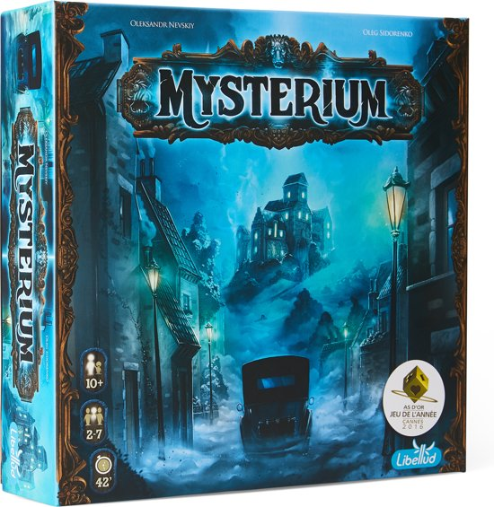
I enjoy…
Instead…
What is fun about Clue?
Feeling like a suuuuuper genius!
The aspect of solving a mystery
What are the problems?
There’s not much more to it
Little to no player interaction
Intuitive people feel left out
Mysterium
Keeps the mystery but adds an incredible amount of player interaction and conversation
You get to feel doubly smart because you get to explain why
Intuitive reasoning is just as valuable as logical reasoning… sometimes more so!

Slide 14
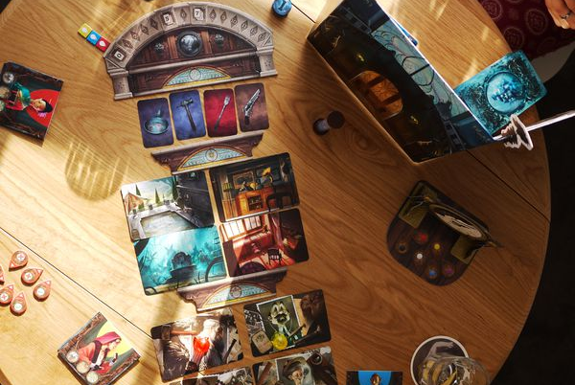
Mysterium
The plot is the same as Clue: the murderer, the room, the weapon. But one player acts as the ghost, giving clues…
…that the other players have to work together to solve.
Mysterium mechanics:
Narrative, Social, Variable Powers

Slide 15
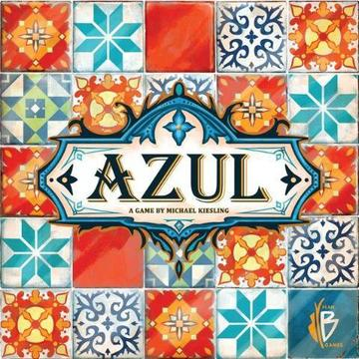
I enjoy…
Instead…
What is fun about Scrabble?
Combinations for high scoring turns
The flash of insight as you see a word
Hitting a special square for high points
What are the problems?
Not everyone likes word games
Lots of dead time between turns
Azul
Keeps the combinations and the flash of insight
Trades words for pictures so everyone can enjoy themselves
Good with two players, great with five

Slide 16
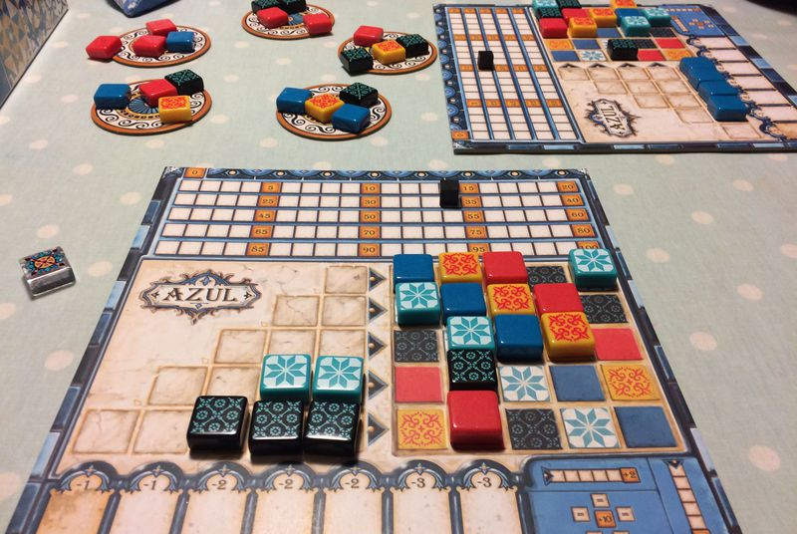
Azul
Score points by laying tiles in patterns, the value for which are based on combos you put together.
The more you can create these combinations, the better you’ll do.
Azul mechanics:
Drafting, Tile Placement

Slide 17
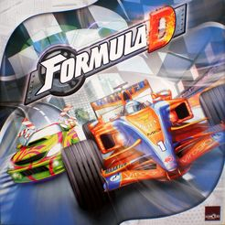
I enjoy…
Instead…
What is fun about Sorry?
You’re in a race!
Reversals of fortune are fun to watch
What are the problems?
Very little to keep adults engaged
Even kids will check out
The game is super repetitive
Formula D
Keeps the fun of racing against others and watching them occasionally get slammed into the wall
Adds some thinking: when should you step on the gas?
Adds engagement for all ages

Slide 18
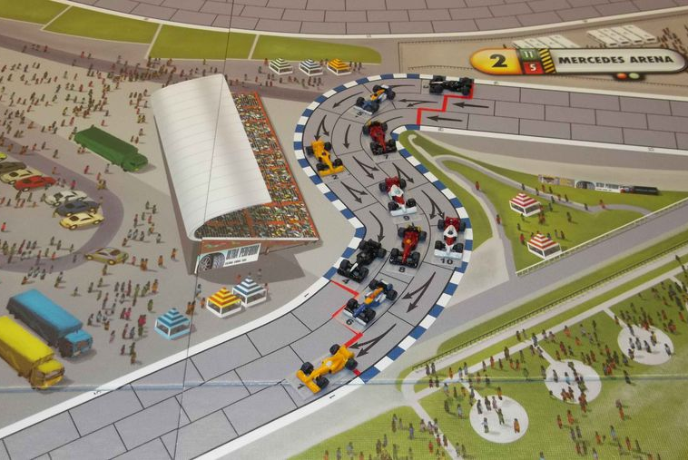
Formula D
Modern racing games are absurdly fun. Risk shooting the corner at high speed… or will you fly through a guardrail into the crowd?
Look at you: you don’t even know the rules and you want to play!
Formula D mechanics:
Drafting, Trading, Variable Powers

Slide 19
I enjoy…
Instead…
What is fun about video games?
The rush of doing well
The feeling of control
What are the problems?
Why did you start playing video games in the first place?
When did we stop showing off in front of our friends?

Slide 20
The other problem
When is the last time a video game made you feel like this?

Slide 21
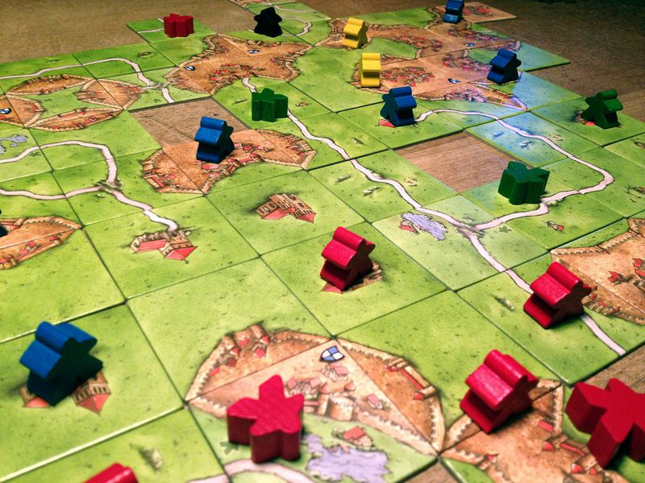
Styles, Genres, Mechanics

Slide 22
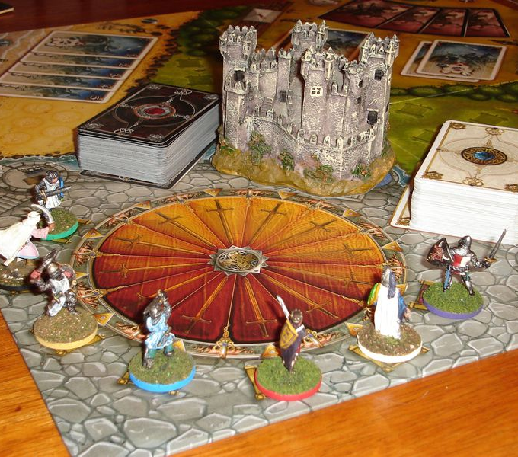
Styles
There are five basic styles of board games to understand
Competitive (Player vs. Player)
Cooperative (Players vs. Game)
One Versus Many (“Hidden Traitor”)
Legacy (Continuing Consequences)
Solo
Shadows Over Camelot

Slide 23
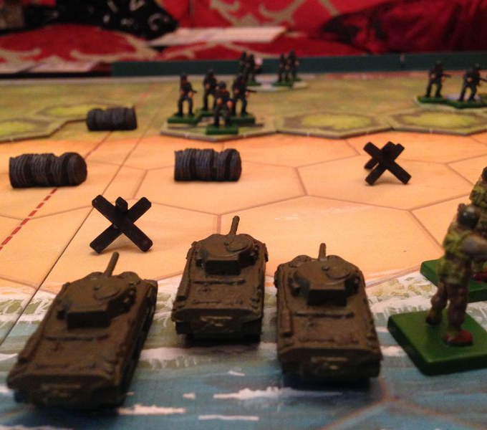
Genres
American style games!
“American style” games grew out of the table-top wargaming scene
Highly competitive and adversarial
Tend toward straightforward rules
Often two-player or team games
Usually feature a strong story
Memoir ‘44

Slide 24
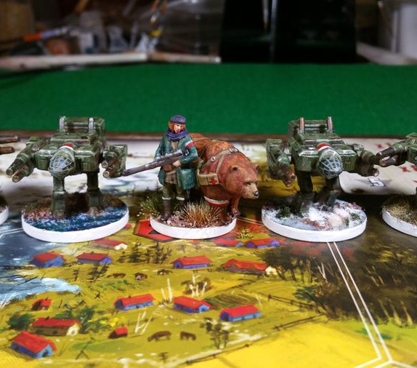
Genres
European style games!
“Euro style” games grew in Germany as a reaction to the American style
Very positive player interaction: trading and negotiating
Tend toward building economies
Complex, “crunchy” rules
Lots of interesting choices!
Scythe

Slide 25
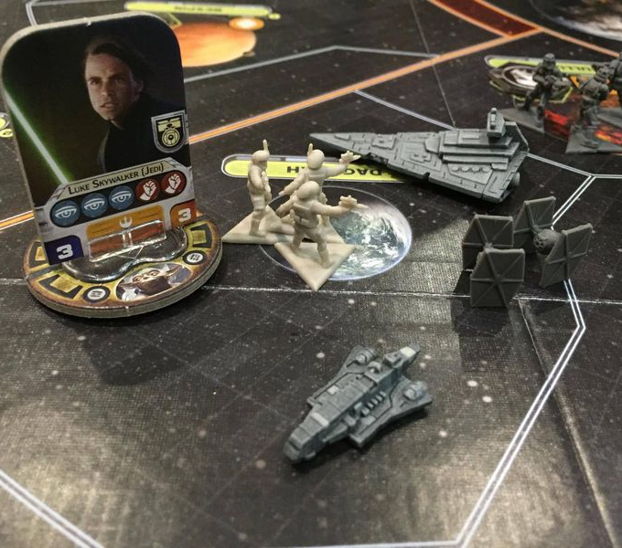
Mechanics
Understanding games is knowing how they work
As the new hobby evolves, game mechanics are being clarified
These structures tell you how the game will flow and what to expect
Understanding the vocabulary will quickly inform you if you will enjoy a game, or if it is not for you
Star Wars: Rebellion

Slide 26
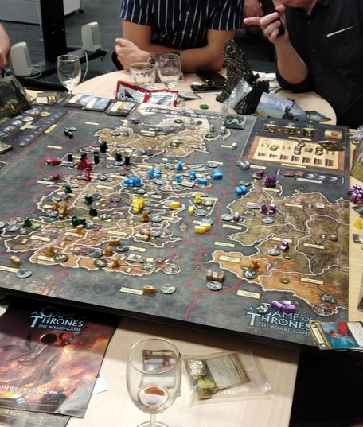
Area Control
Take control of a region of the board, exploit its resources
The classic board game Risk employs this mechanic, as do some tabletop war games
Modern games have expanded the mechanic to include production of varying resources, trade, and negotiation with other players
Example: A Game of Thrones

Slide 27
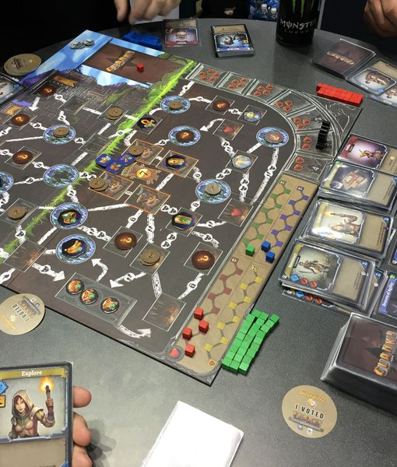
Deck Building
Mix cards you select into random order for later use
First employed by the CCG Magic: The Gathering, this mechanic has been incorporated into dozens of games
This includes not only card deck building, but “bag building” which might include tokens or dice denoting powers or resources to be used later in the game
Example: Clank!

Slide 28
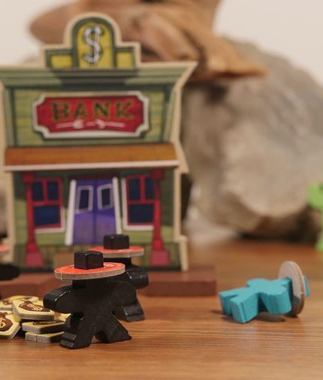
Dexterity
Games that are driven by player hand-eye coordination
The kid’s game Operation challenged you to use dexterity to remove pieces from the board... with tweezers
Modern variants build such dexterity puzzles right into the game: in Flick ‘em Up, you flick little wooden bullets at little wooden cowboys in little cardboard hats
Example: Flick ‘em Up!

Slide 29
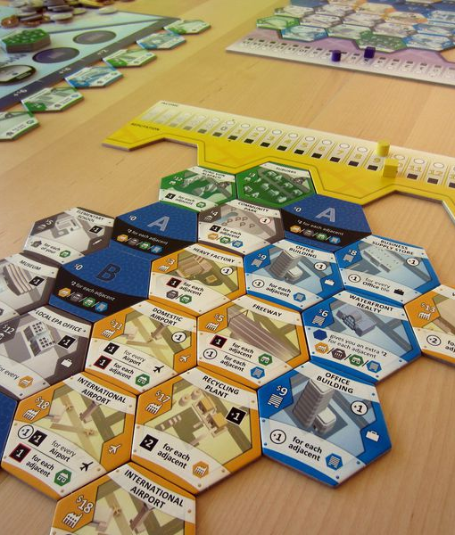
Drafting
Choose or “buy” cards, tiles, or dice from a common pool
This mechanic places all the possible outcomes and capabilities into a common store from which all players draw choices
Different choices by the various players produce different outcomes, some successful, some failed
Example: Suburbia

Slide 30
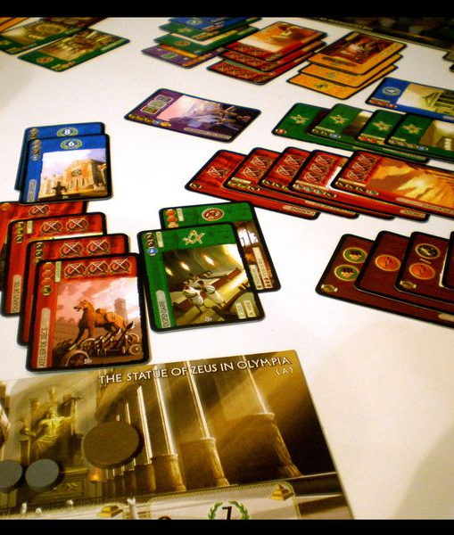
Economics
Build an economy for the production of game goals
In economic games, you build an economy which then produces the pieces or points you use to win
Euro games usually make the points the victory condition; American games add economy to either story or combat
Example: 7 Wonders

Slide 31
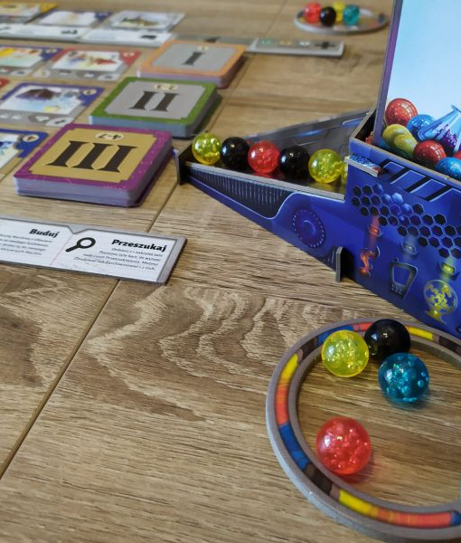
Engine Building
Turn one action into many by creating reinforcing moves
Engine builders usually challenge you to draw cards that work together in combination
The intended combination is to get one turn to give you the effects of many turns
Example: Gizmos

Slide 32
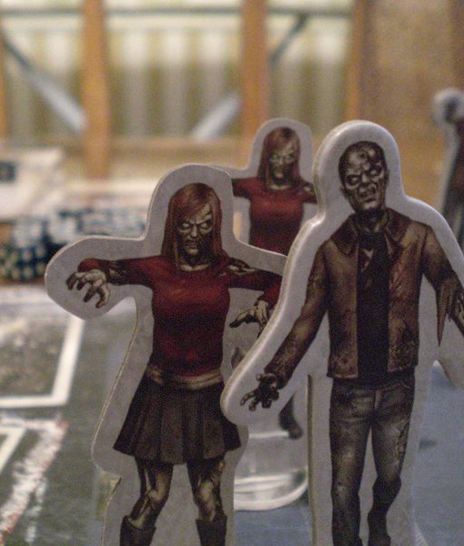
Narrative
The game revolves around telling a story to the players
Nearly always combined with other mechanics, but narrative games are primarily interested in telling their players a story
Such games have specific story-telling elements that are explicitly included in the mechanics, such as “story decks” or “encounters”
Example: Dead of Winter

Slide 33
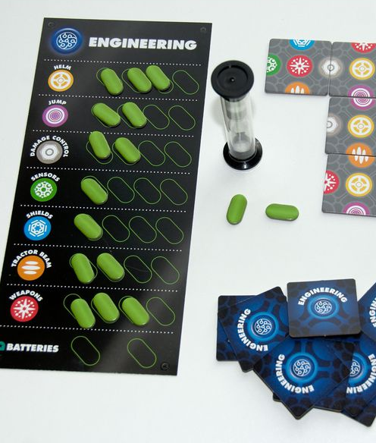
Real-Time
The clock is ticking and you have limited time to act!
Usually co-op games that include a ticking clock, and often combine that mechanic with “mini games” that each player must solve within a time limit
How each player does with their individual challenge defines how successful the group will be
Example: Space Cadets

Slide 34
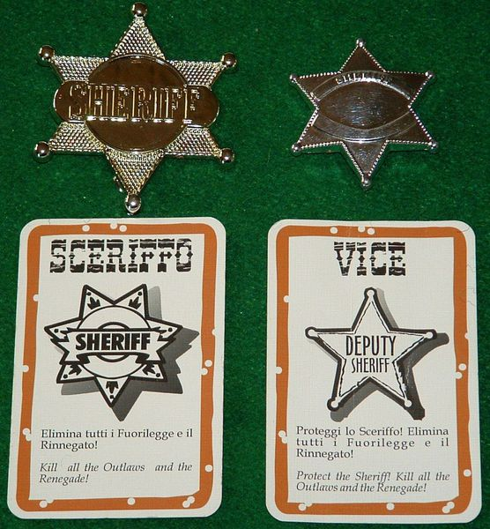
Social / Roles
The game revolves around player interaction
The entire game is driven by social interaction, role-playing, voting, and negotiations
Such games are often combined with “hidden traitor” mechanics which secretly set one or two players against the rest
Example: Bang!

Slide 35
Tile Placement
Build the board as you play, with each player expanding it
The table or just your side of it starts as a blank, empty space: a board game with no board!
Players take turns placing tiles down which slowly builds the board. No two games are alike.
Example: Carcassonne

Slide 36
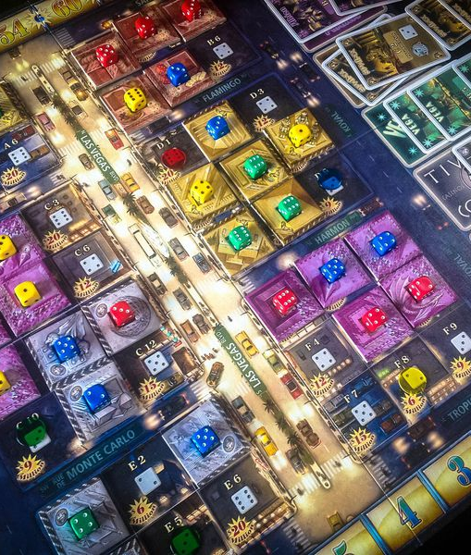
Trading / Auction
The game’s mechanics rely on interaction and making deals
Trading games build a significant portion of the game play around players making deals… everything is tradeable!
Such games often have negotiation or take-over mechanics to shake up the board state, and auctions for control of resources
Example: Lords of Vegas

Slide 37
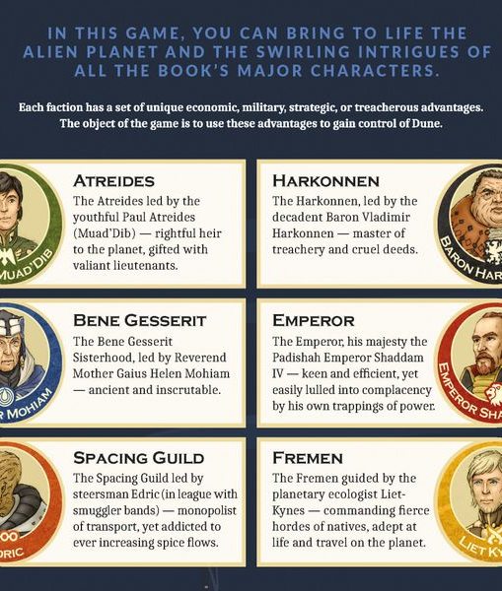
Variable Powers
Every player starts the game with or gains unique abilities
In virtually every classic board game, every player started with the same abilities, resources, actions, and rules
This is not always the case with modern board games, which often start players with one or two abilities that are unique to each
Example: Dune (2019)

Slide 38
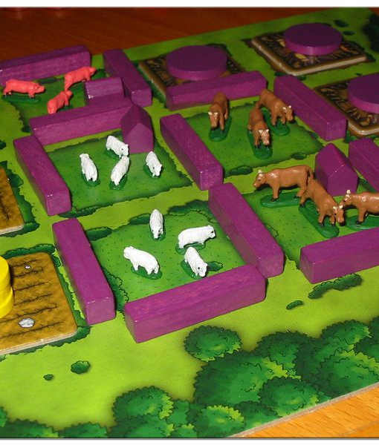
Worker Placement
Place tokens on areas to show actions and block others
You may have heard of the first worker placement game: tic-tac-toe
Tokens are placed on designated areas of the board to select actions and (usually) prevent other players from selecting the same action that turn
Example: Agricola

Slide 39
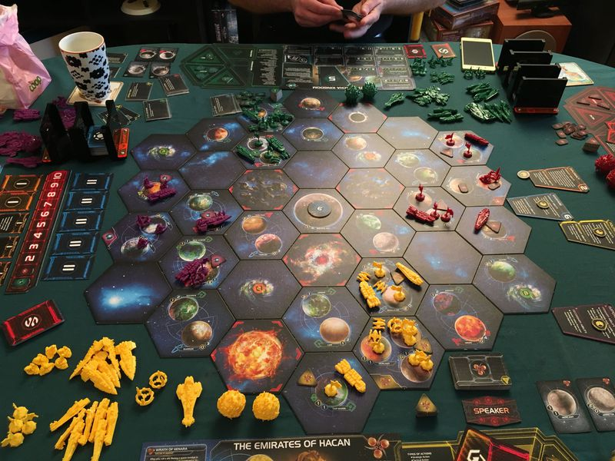
New Classics
Twilight Imperium

Slide 40
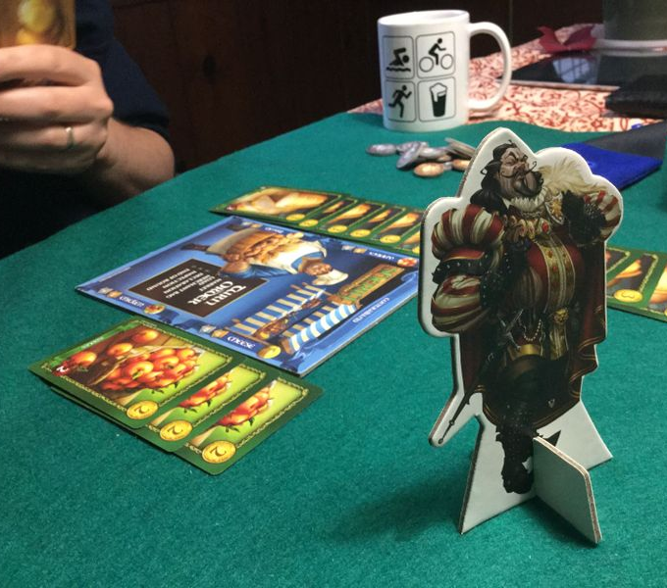
New Classics
Board games are booming, with new games every year
Companies are introducing new games at conventions, during the holidays, and on-line
These new board games take existing mechanics and combine them in new ways, or tell stories
Some completely new types of board games are also appearing
Sheriff of Nottingham

Slide 41
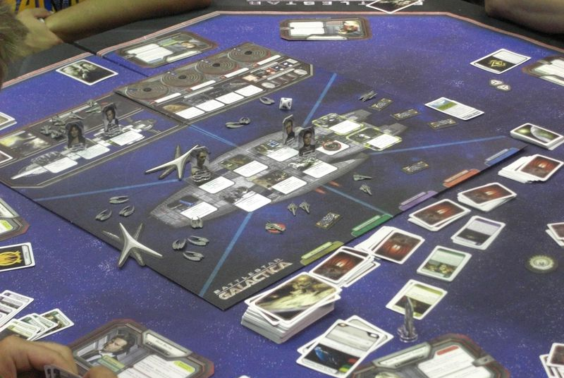
Battlestar Galactica
The foremost “hidden traitor” game uses paranoia to ensure every game is memorable.
Which of your friends is a Cylon?
Battlestar Galactica mechanics:
Drafting, Narrative, Roles, Variable Powers

Slide 42
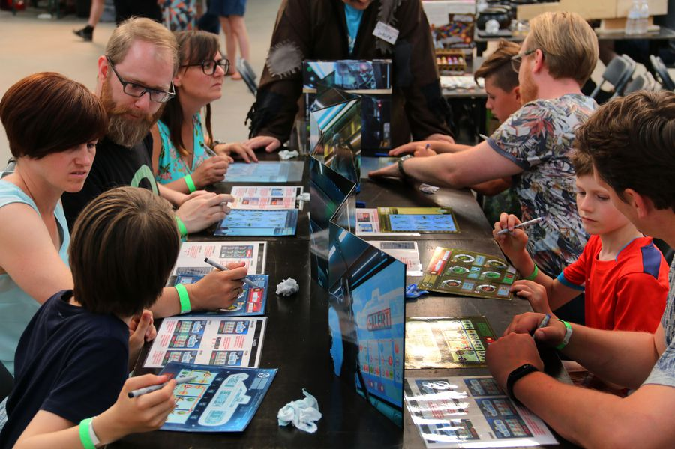
Captain Sonar
Work together as the crew of a submarine, hunting an enemy… who are hunting you!
Can you cooperate better than the other team?
Captain Sonar mechanics:
Real-time, Roles, Variable Powers

Slide 43
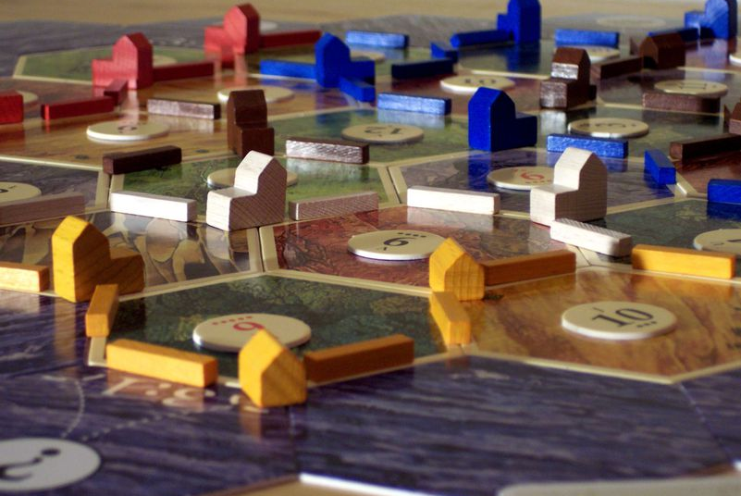
Catan
Catan (or Settlers of Catan) cleverly mixes area control with non-confrontational play.
25 years old now, it’s available in a huge number of variants.
Catan mechanics:
Area Control, Economy, Trading

Slide 44
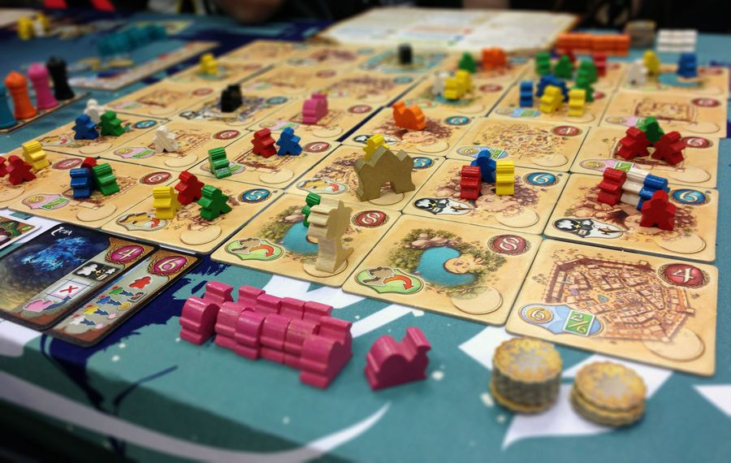
Five Tribes
Competitive puzzle game in which players capture spaces using movement of tokens.
Loosely based on one of the world’s oldest games, Mancala.
Five Tribes mechanics:
Auction, Drafting

Slide 45
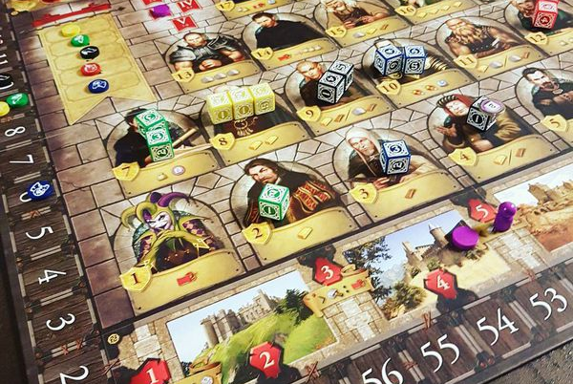
Kingsburg
Roll dice, put your dice on spaces matching what you rolled. It seems like a simple kid’s game…
…until you play it.
Kingsburg mechanics:
Economy, Worker Placement

Slide 46
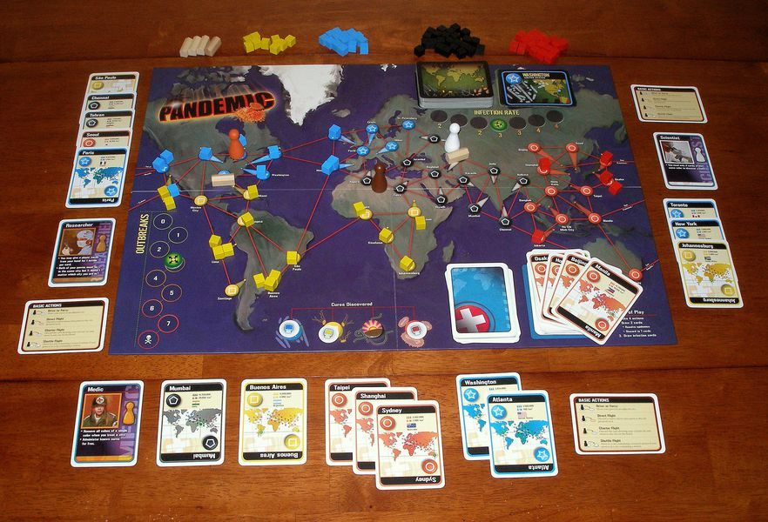
Pandemic
Cooperative or solo game in which four epidemics threaten to wipe out the world.
A game that ratchets up the tension level!
Pandemic mechanics:
Deck Building, Social, Variable Powers

Slide 47
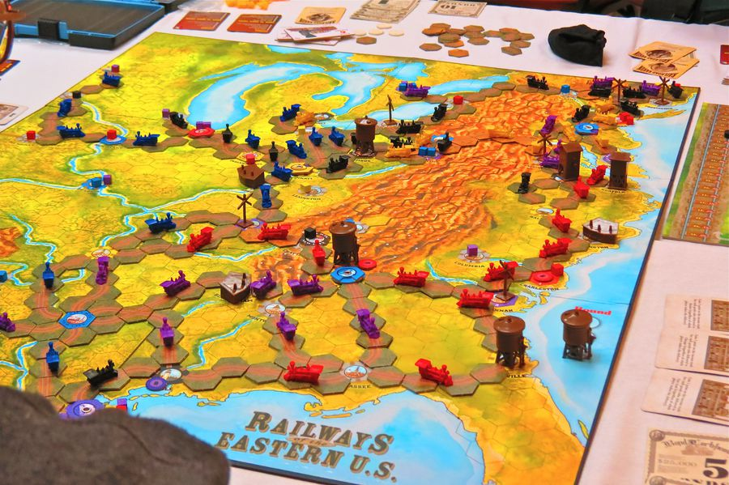
Railways of the World
Become a railroad tycoon and take control of a piece of the expanding frontier!
Will you build track, ship cargo, control routes… or all three?
Railways of the World mechanics:
Auction, Drafting, Tile Placement

Slide 48
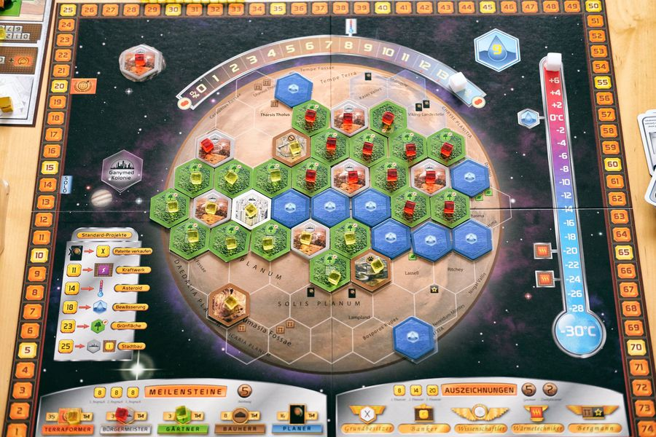
Terraforming Mars
Terraform our nearest solar neighbor…
Farm algae, build cities, or slam comets into the planet (or into your competitors).
Terraforming Mars mechanics:
Area Control, Drafting, Economics, Engine Building, Tile Placement

Slide 49
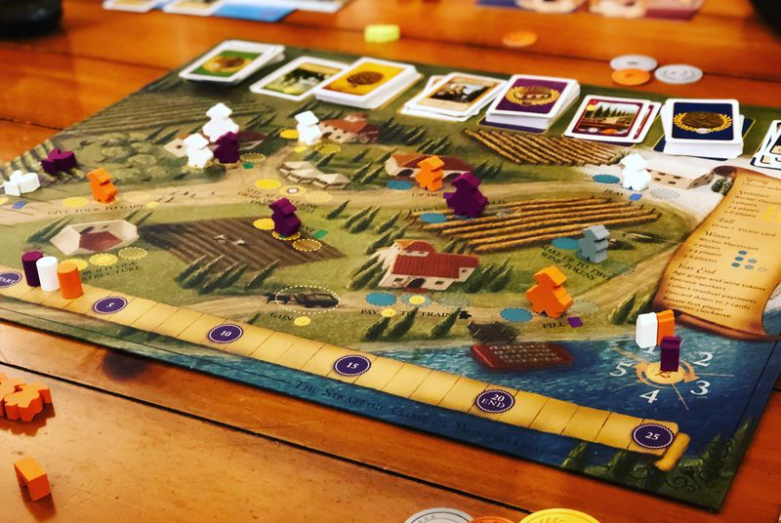
Viticulture
Ever wanted to own your own vineyard?
Place workers to grow grapes, produce wine, sell it, and manage your winery.
Viticulture mechanics:
Drafting, Economy, Worker Placement

Slide 50
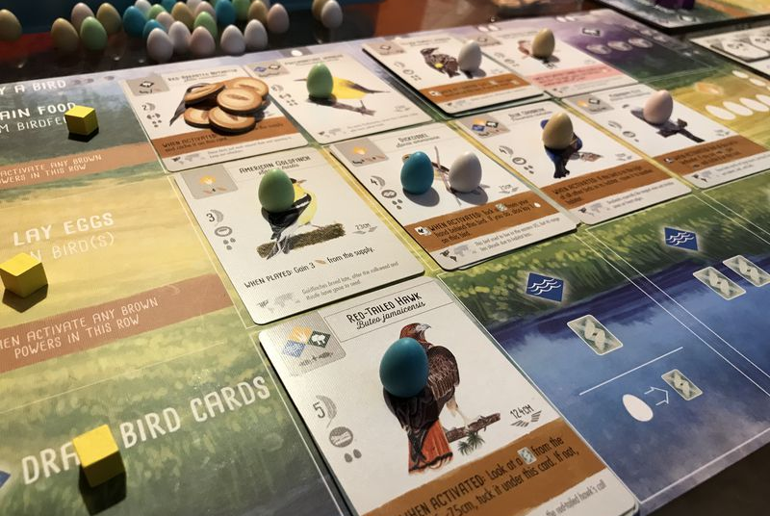
Wingspan
Great introduction to engine building.
Manage an aviary by drafting, feeding, and managing a suite of complimentary birds.
Wingspan mechanics:
Drafting, Engine Building

Slide 51
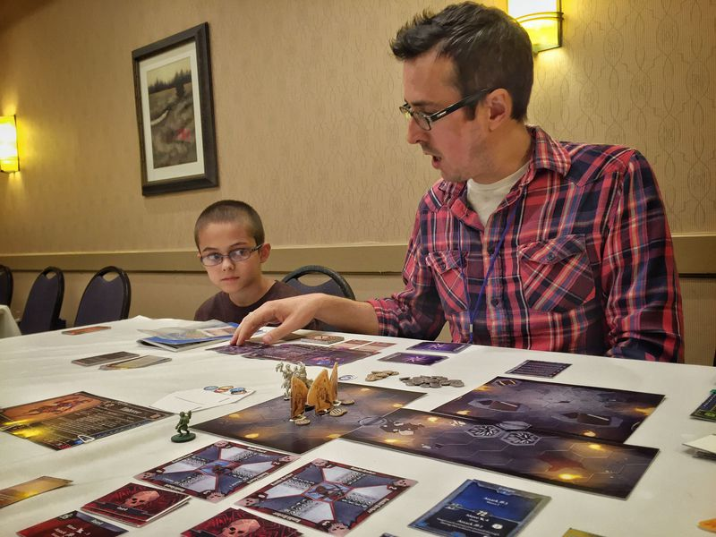
Get involved!
Gloomhaven

Slide 52
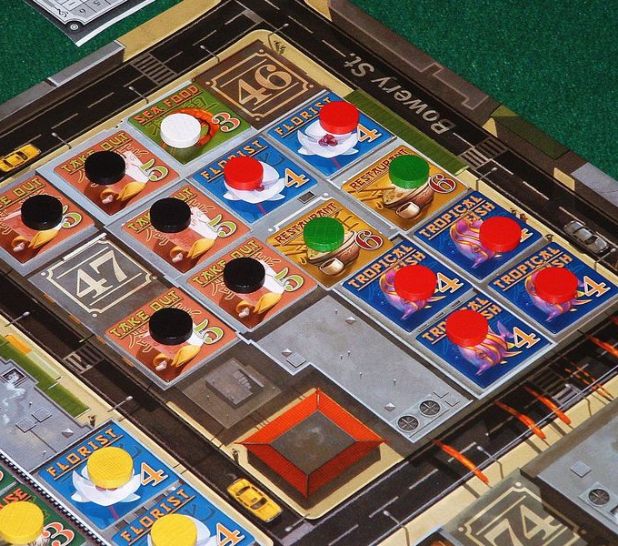
Sign Me Up
How do I get involved?
Joining the hobby is easy enough: just find a table and ask to join in!
You might even go nuts and buy a board game or two yourself (warning: it’s addictive!)
But where do you get started and how can you learn more?
Chinatown

Slide 53
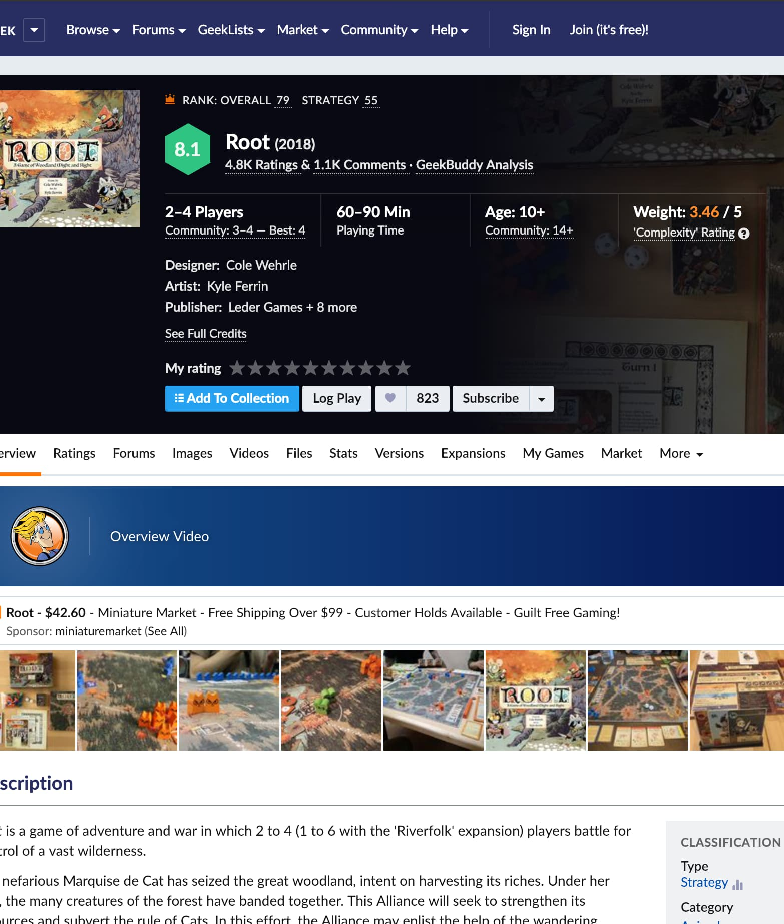
Community
A great way to learn…
A number of ratings websites are available that will teach you about the games
The most popular is boardgamegeek.com
Look up virtually any game released in the last hundred years or so, get information, style, mechanics, pictures, reviews
Board gaming forum for asking questions, getting rules clarifications, talking to others
Rate your favorite games, build a wish list!
Contact other local board gamers
boardgamegeek.com

Slide 54
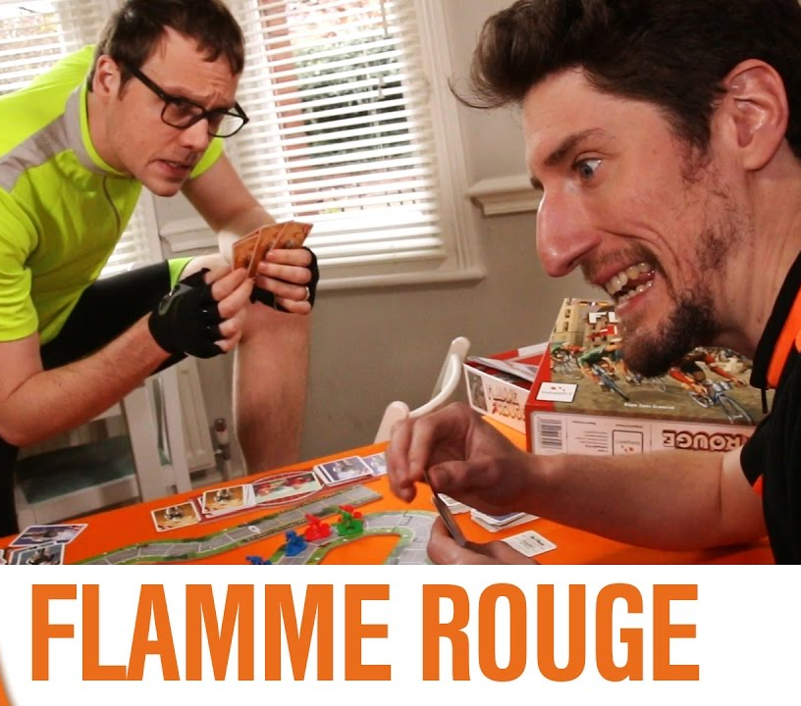
Youtube
Youtubers review board games and provide play-throughs
Some of my favorites:
Shut Up & Sit Down (shutupandsitdown.com)
Youtube: Shut Up & Sit Down
Youtube: Rahdo
Youtube: The Dice Tower
Youtube: Watch It Played
Youtube: 3 Minute Board Games

Slide 55
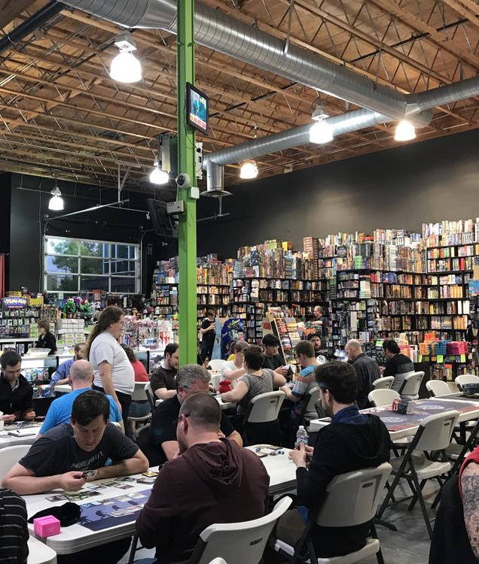
Your FLGS
Support your FLGS (Friendly Local Game Store)
It will be tempting to make all of your purchases on Amazon…
It’s a valid choice, but give your FLGS a chance to win your business: compare prices! See what’s out there!
If your FLGS price is within one or two coffees of the Amazon price, buy local!
Buying local expands the local stores, expands the local market, and expands the hobby, with more gaming groups available
Guardian Games
Portland, OR

Slide 56
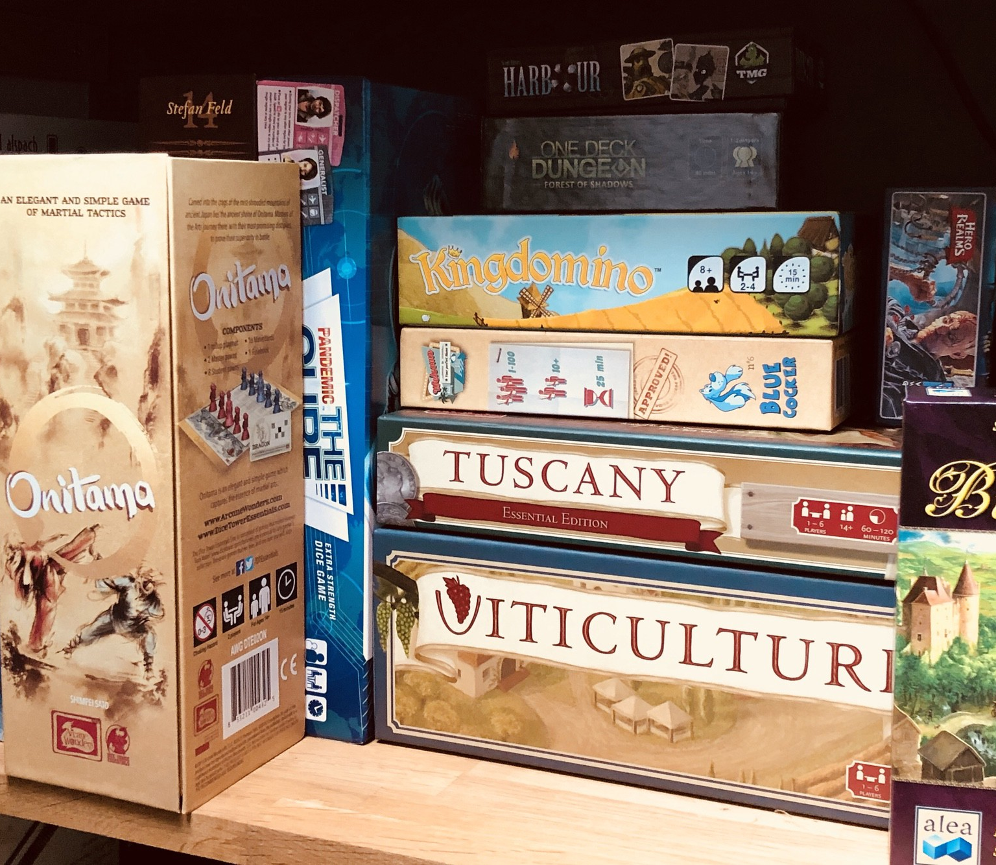
Thank You!
Ross Glenn

